Slide 1
De-AI : A tool for AI code detection

Slide 2
The TEAM
Biproteep Roy (2020CSB053)
Taaha Siddiqui Mohammed (2020CSB079)
Kuldip Kundu (2020CSB022)
under the supervision of
Prof. Manas Hira

Slide 3
Index
Objective
Motivation
Generative AI
The Differentiation
Functional Requirements
Design
Writing our model
Implementation as an web tool
Future Scope
References

Slide 4
Objective
Predicting if a submitted code is written by human or a generative AI tool.

Slide 5
Motivation
Verifying the trustworthiness of code, especially in critical or security-sensitive applications
Mitigating concerns related to plagiarism, intellectual property, and misuse of AI-generated code.
Meeting regulatory requirements for disclosure and use of AI-generated content in specific industries.

Slide 6
Generative AI
How do existing Generative AI models work?
Receive text-based input(prompt) from user.
Find the context behind the input or query.
Refer to its large collection of data it is trained on.
Use NLP techniques to understand structure, semantics, and user intent.
Generate answers based on predictions made from the context of the input and the retrieved information.

Slide 7
How AI writes code for a given problem statement?
Derive context based on the instructions and specifications of the problem statement.
Uses its pre-trained programming language knowledge as well as publicly available source code it trained on to generate a nearly consistent answer to the solution.
Codes thus generated will have proper syntax as well as similar sentence length for all its generated answers.
The generative AI tries to reach the best possible solution it can, while also maintaining a certain degree of randomness in the generated code.
Generates perfect solutions for simpler problems but fails to give a definite solution for complex problems.

Slide 8
How AI Content Detection works
There already are powerful tools that very accurately can determine if the piece of content is AI or human generated.
Most of the tools make their predictions based on two important indicators:
Perplexity: It is the amount of randomness in the generated content. AI generated contents usually have very low perplexity, meaning that the generated content will be easily predictable. Human generated content on the other hand has a very high perplexity, indicating high randomness.
Burstiness: It is the amount of dissimilarity in sentence width in the content. AI generated content usual has uniform sentences whereas in human generated content, it is quite random.
These two indicators decide the complexity of the text. Based on this information, the content is then classified.

Slide 9
How an AI generated code MAY differ from a human-written one
 | AI-generated code | Human-written code
Optimization | May have less number of nested loops | New programmers may not be able to write optimized code
Approach | Most of the time they find the popular/most common approach | A student may find widely unconventional approaches
Innovation | AI generates code from previous knowledge | High chances of beautiful innovation
Coding standards violation | AI hardly violates coding standards | Humans are prone to violating coding standards
Commenting | Proper commenting is done by AI | Most students don’t bother writing comments

Slide 10
Issues Related to predicting if the Code is Human or Ai Generated
With the rapid advancement of Generative AI tools, the distinction between what is human generated and what is AI generated is becoming blurry. A simple prompt to "Make it look human" can fool even the best AI content detection tools that exist in the market.
The existing models for AI content detection make predictions based on how predictable the content is and how uniform the sentence lengths are. For simpler problems, varying the code to be different from the existing codes is quite difficult.
Using the parameters mentioned in the table in the previous slide, predicting whether the code is human or AI generated would be unfair for veteran programmers and people who adhere to strict coding standards. This model punishes perfectionists.
It is very easy to modify the code to look human once the parameters for detection are known.

Slide 11
Functional requirements
Support for C/C++ languages
Submission of code to the model
Shows prediction whether a code is AI generated or not

Slide 12
Creating the model
Input
The user inputs the code to be analyzed
Processing
The code will be processed to generate Word Vectors and sent to the server
Analysis
The code is analyzed by a pre-trained Neural Network
The user is let known if the code submitted was AI written or not
Result Generation

Slide 13
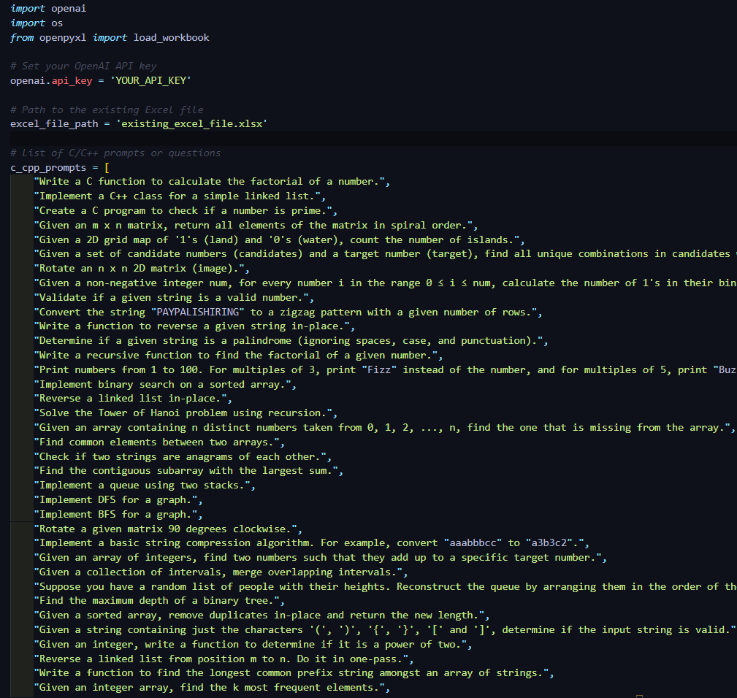
Data Collection
AI Generated code | Human generated code
We wrote a python script that uses ChatGPT to generate AI written code in bulk. We needed OpenAI API access for that. | 1000 human written C++ codes were collected from our own batchmates.

Slide 14
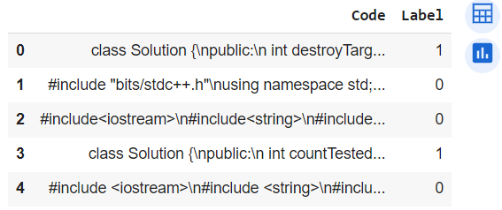
Preprocessing of dataset
All the codes were collected into a single CSV file.
The first column had all the codes and the second column contained the labels.
A label ‘0’ means AI-generated code whereas ‘1’ means Human written code.
The CSV file was then converted to a Pandas dataframe.

Slide 15
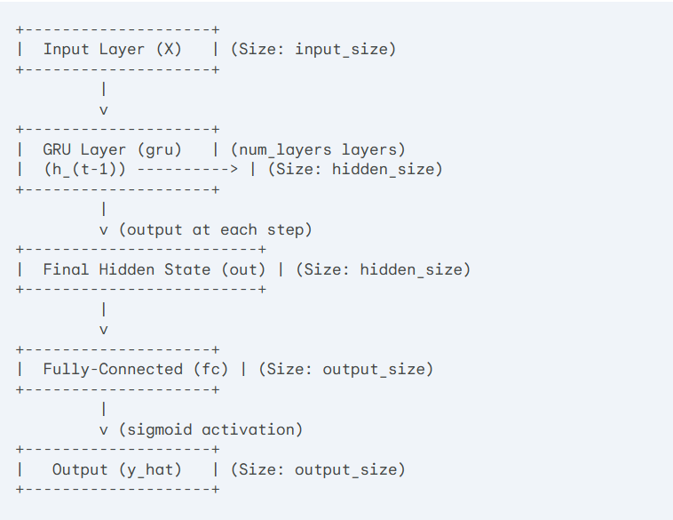
Neural Network Architecture
First, we use T5Tokenizer to parse the code and tokenize it into vectors.
Those vectors are taken as inputs in the neural network, which consists of several layers of GRU and finally a layer with sigmoid activation for Binary Classification.
Next we train the model using our tokenized code-dataset.

Slide 16
Explanation of Architecture
Input Layer (X): This layer receives the input sequence. The size of this layer is input_size, which represents the dimensionality of each element in the sequence (e.g., word embedding size after tokenization).
GRU Layer (gru): This is the core of the model, consisting of num_layers stacked GRU units. At each time step: The current input (X_t) and the previous hidden state (h_(t-1)) are fed into the GRU layer. The GRU layer uses gates to control the flow of information and update the hidden state (h_t), capturing contextual information from the sequence.
Final Hidden State (out): This represents the output from the final GRU layer in the stack. It encapsulates the most relevant information from the entire sequence.
Fully-Connected Layer (fc): This layer performs a linear transformation on the final hidden state (out) to project it into the desired output size (output_size).
Output (y_hat): This layer applies a sigmoid activation function to the output from the fully-connected layer. Since output_size is set to 1 for binary classification, the sigmoid function transforms the output into a probability between 0 and 1, representing the model's prediction for the class.

Slide 17
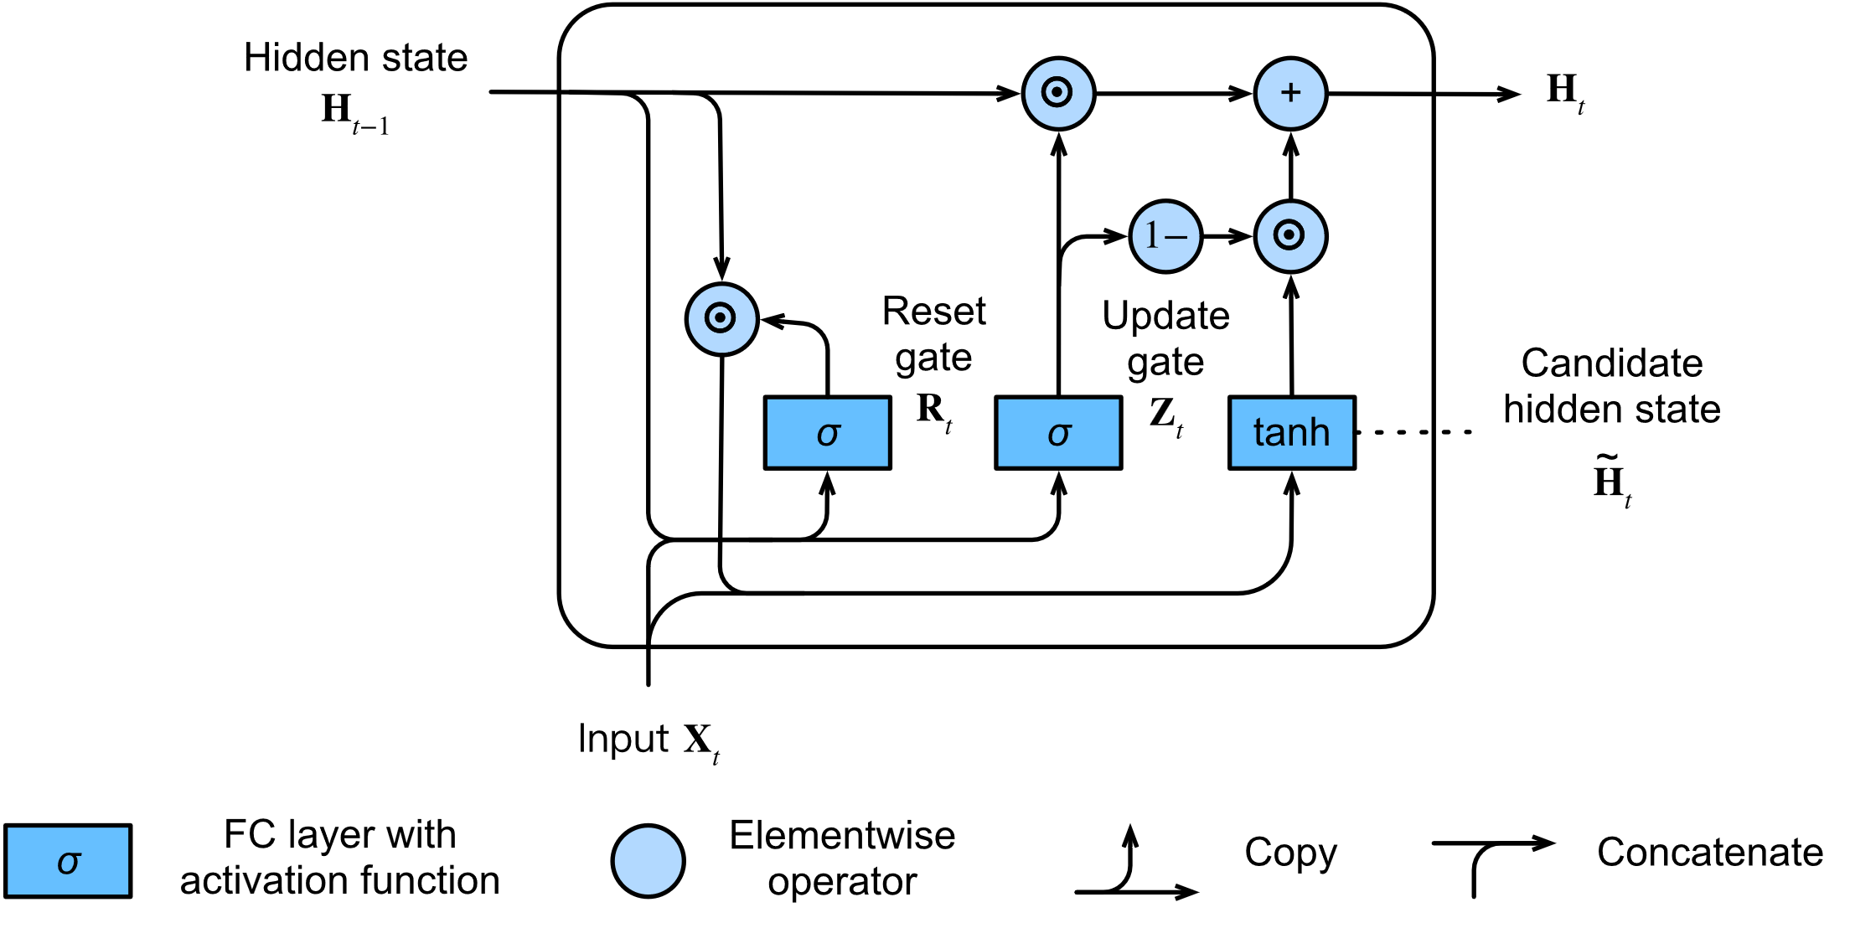
WHY GRU?
GRU is designed to model sequential data by allowing information to be selectively remembered or forgotten over time. However, GRU has a simpler architecture than LSTM, with fewer parameters, which can make it easier to train and more computationally efficient.

Slide 18
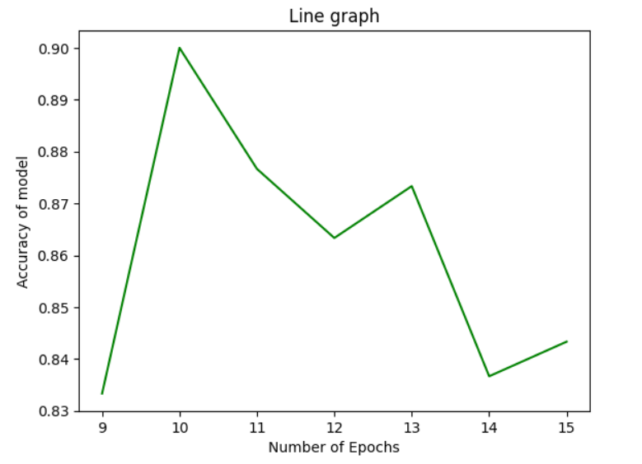
Training and testing
Split ratio: 85:15
Batch size: 512
Number of
epochs: (Varying)

Slide 19
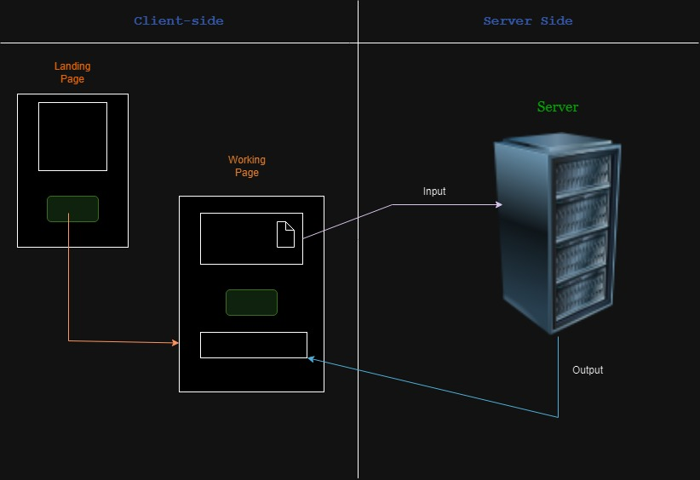
SYSTEM ARCHITECTURE

Slide 20
Implementation as an web-based tool
Developed a website for the homepage and the actual working page using the Web3 tools.
The script for the model has been included in the Flask application.
Started a ngrok server in order to access the running Flask application from the HTML code.
In the actual working page, we have included a JS script that will be used to connect to the Flask application in the background.
Output is retrieved from the Flask application and shown on the website.

Slide 21
WEBSITE DESIGN
Home Page:
“Get Started” Button:
To go to working page
Working Page:
Input Text Box:
The user types in / pastes the content to be reviewed.
Submit Button:
On clicking, it will send the data to the server for further processing as a POST request.
Prediction Display:
This will display the prediction of the content being generated by AI or human. This output is received from the server.

Slide 22
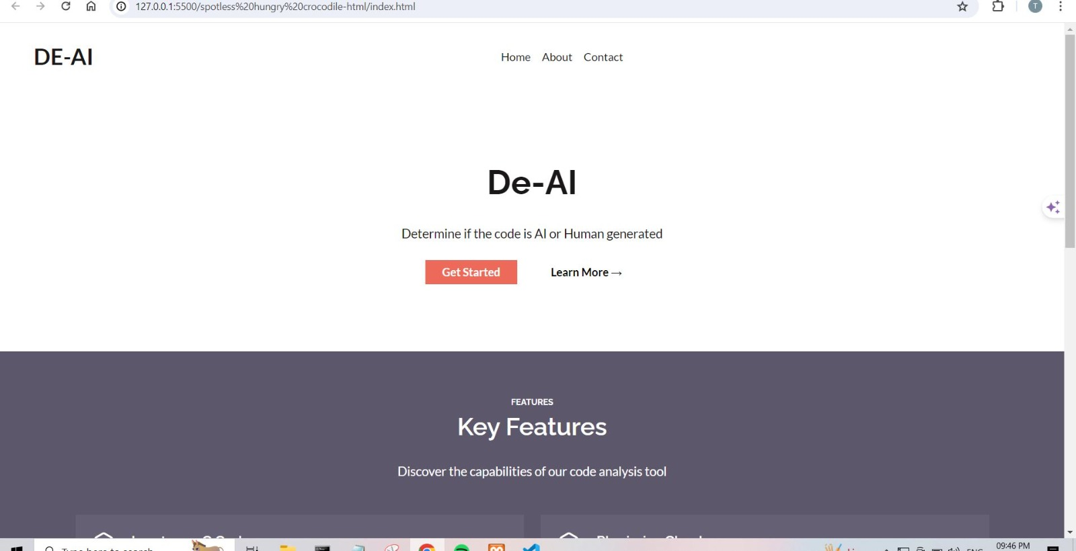
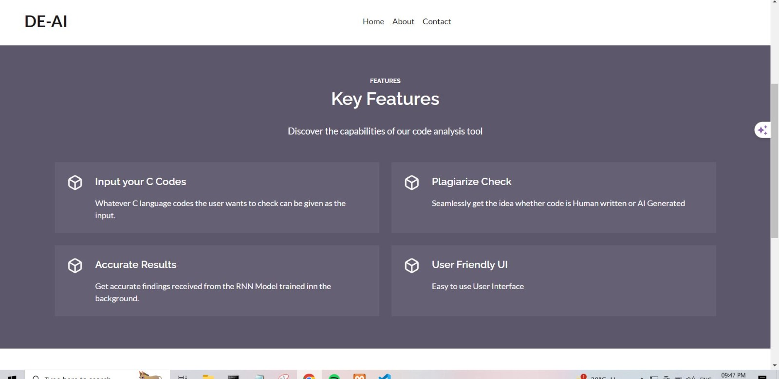
Landing page

Slide 23
Server(Flask Application):
Input will be received from the web interface
A Deep Learning model will be running on the server continuously which analyses the input code
The output, that is the prediction, will be provided to the interface again

Slide 24
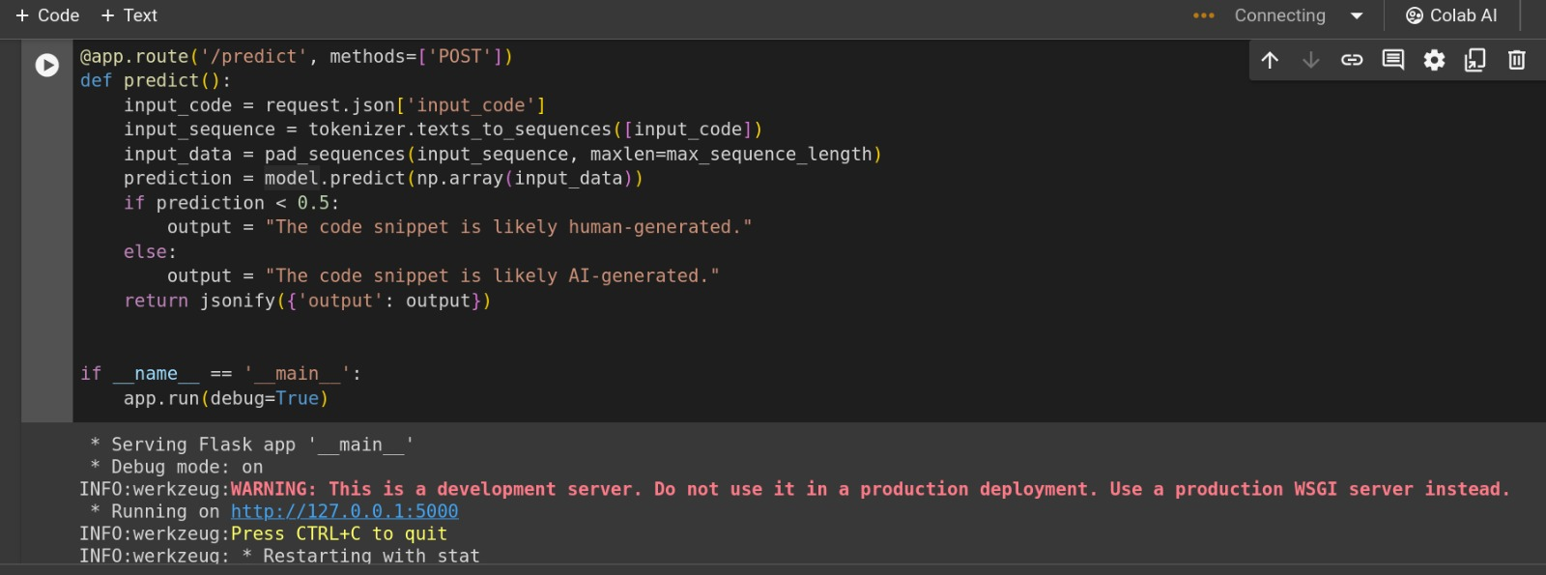
Running flask application

Slide 25
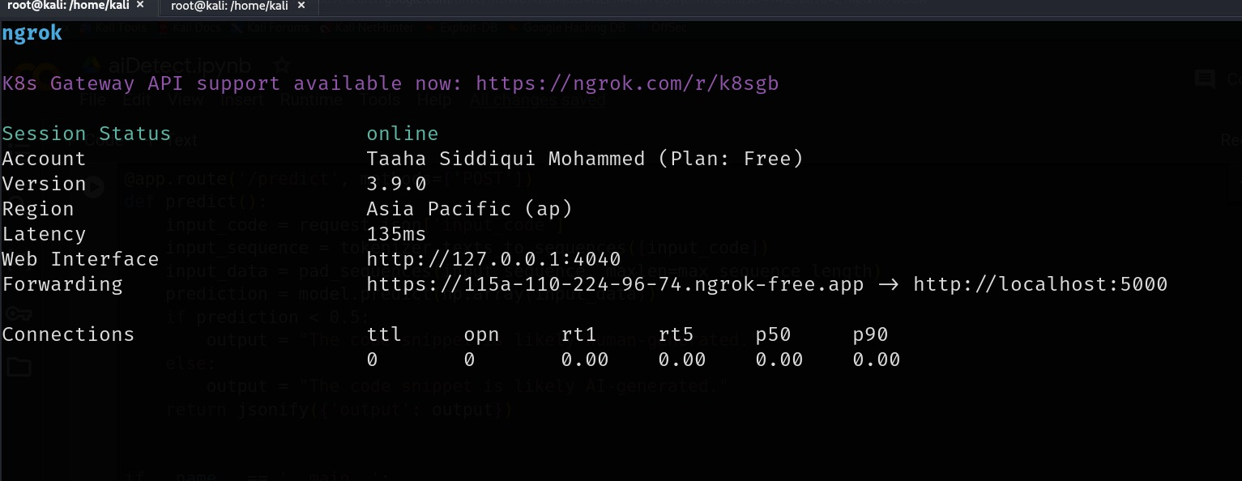
NGROK server

Slide 26
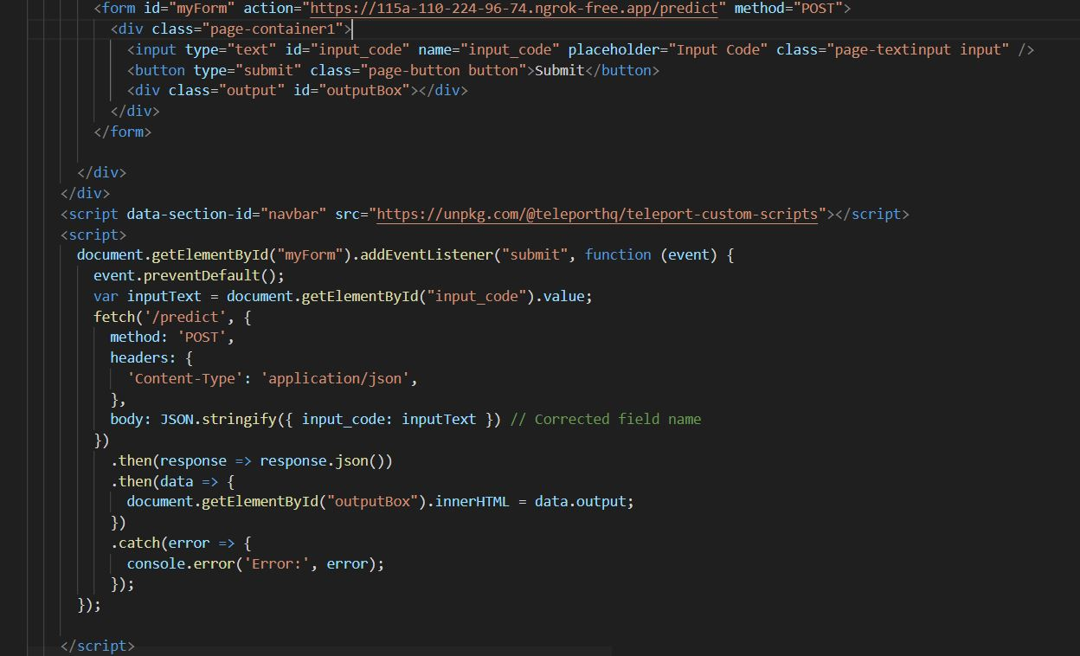
HTML code to connect to Flask application

Slide 27
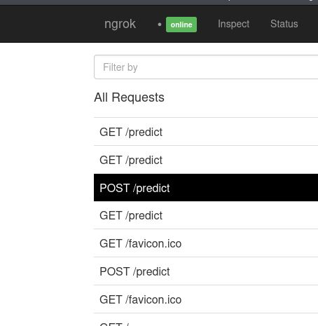
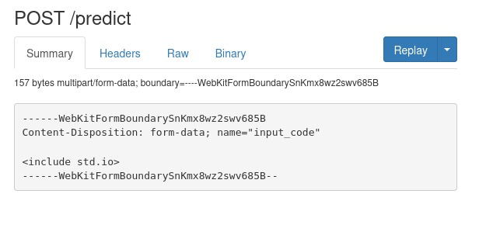
Ngrok log

Slide 28
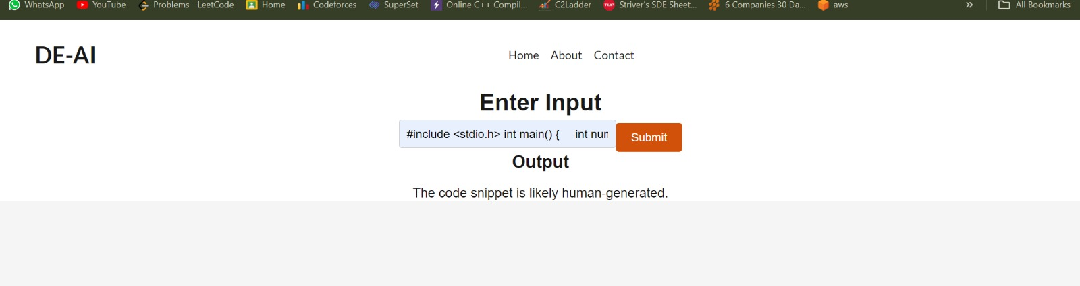
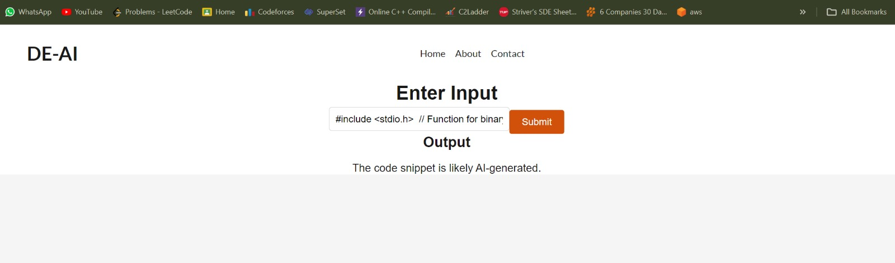
Results

Slide 29
Future Scope
More accuracy to be obtained. Bigger dataset.
Support more programming languages besides C/C++
Personalized detection

Slide 30
References:
https://medium.com/swlh/simple-explanation-of-recurrent-neural-network-rnn-1285749cc363
https://dataaspirant.com/how-recurrent-neural-network-rnn-works/
https://www.researchgate.net/figure/Single-hidden-layer-FFNN-fully-connected-structure-with-sigmoid-transfer-function-and_fig2_336722473
https://bard.google.com/
https://chat.openai.com/
https://github.com/Copyleaks/PHP-Plagiarism-Checker/tree/master
https://www.tribunewired.com/2023/02/05/gptzero-princeton-student-built-an-app-to-detect-chatgpt-ai-written-text/
The Emperor’s New Mind by Roger Penrose

Slide 31
THANK YOU

